Slide 1
Are You Fit for HealthKit?
Igor Kantor
360iDev 2017
Demo App:
https://github.com/Iiiggs/AsthmaBuddy
Notes:
- Hello and Welcome
How is sounds in the back?
If playing along, pull down the app

Slide 2

Igor Kantor
iOS Dev, DaVita, Mobile Community of Excellence
Live in Denver, 4 years
7 month-old baby girl Alexandra ->
Twitter, GitHub: @Iiiggs
Riding century in Buffalo Classic
Notes:
Igor Kantor
Work at DaVita, Mobile Community of Excellence
Patient Engagement and other apps
Certification
Denver for 4 years

Slide 3

Notes:
We are in Colorado
Beautiful mountains, check them out if you have time

Slide 4

Notes:
- Gold rush played a part in getting people here starting in 1859

Slide 5
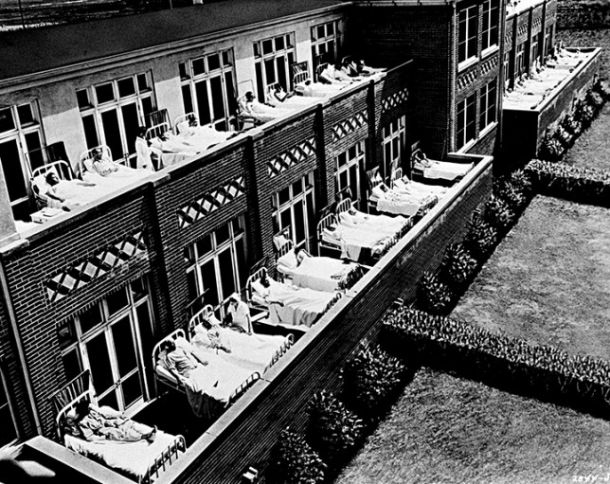
Notes:
- TB was top killer of Americans in late 1800s and early 1900s
No cure at the time, so healthcare providers urged people to head out of cities to places like Colorado
In the 1880s and 1890s, it is estimated that one-third of the people living in Colorado Springs had tuberculosis
By one estimate, 60 percent of the state’s population in 1925 came to Colorado because of TB.
Fortunately a cure was developed during WW II

Slide 6
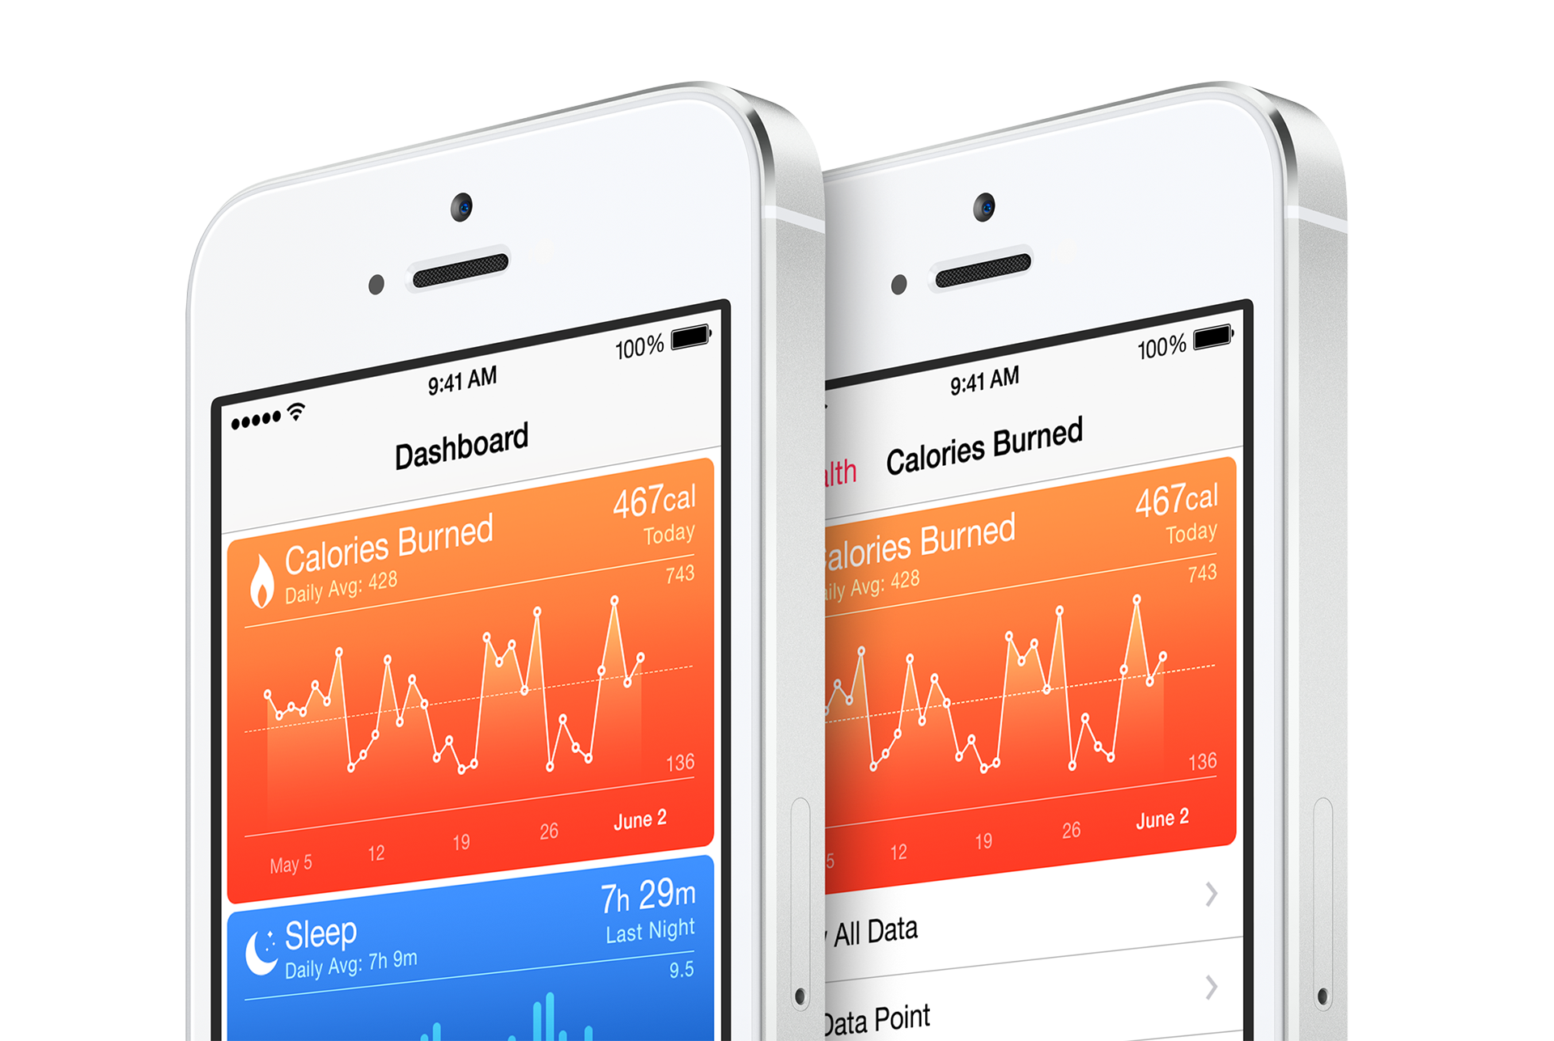
Notes:
Fortunately we have come a long way in both treatment of disease and wellness monitoring
Apple introduced HealthKit in 2014 with iOS 8

Slide 7
https://www.linkedin.com/pulse/connecting-ios-your-emr-using-healthkit-cda-part-two-eric-whitley
Notes:
Data store and set of services
On device
Protected behind Apple’s authorization
Allows for broad range of apps and devices to share/update data

Slide 8

Roadmap
HealthKit Type System Explained
Building AsthmaBuddy with HealthKit, ResearchKit and MapKit
Sample code: https://github.com/Iiiggs/AsthmaBuddy
HIPAA Compliance and You

Slide 9
I. HealthKit Types Explained
Notes:
- Nice use of generic types
- Represent variety of data

Slide 10
// HKHealthStore
if (HKHealthStore.isHealthDataAvailable()) {
let healthStore = HKHealthStore()
healthStore.requestAuthorization(
toShare: types,
read: types)
{_,_ in print("check response")}
}
Notes:
Main interface to HealthKit
Check for support
Instantiate – Apple recomends one
Request granular authorization

Slide 11
// HKObjectType
let dobType = HKObjectType.characteristicType(forIdentifier:
HKCharacteristicTypeIdentifier.dateOfBirth)
let activitySummaryType = HKObjectType.activitySummaryType()
let inhalerUsageType = HKObjectType.quantityType(forIdentifier:
HKQuantityTypeIdentifier.inhalerUsage)
Notes:
Used to describe data type
Charactersics don’t change
Activity summary is the rings on Apple watch
Sample types have start, end

Slide 12
// HKCharacteristicType
let genderType = HKObjectType.characteristicType(
forIdentifier: HKCharacteristicTypeIdentifier.biologicalSex)
let bloodType = HKObjectType.characteristicType(
forIdentifier: HKCharacteristicTypeIdentifier.bloodType)
let dobType = HKObjectType.characteristicType(
forIdentifier: HKCharacteristicTypeIdentifier.dateOfBirth)
Notes:
The HKCharacteristicType class is a concrete subclass of the HKObjectType class. HealthKit uses characteristic types to represent data that does not typically change over time. Unlike the other object types, characteristic types cannot be used to create new HealthKit objects. Instead, users must enter and edit their characteristic data using the Health app. Characteristic types are used only when asking for permission to read data from the HealthKit store.

Slide 13
// HKSampleType
let categoryType = HKObjectType.categoryType(
forIdentifier: HKCategoryTypeIdentifier.sleepAnalysis)
let correlationType = HKObjectType.correlationType(
forIdentifier: HKCorrelationTypeIdentifier.bloodPressure)
let quantityType = HKObjectType.quantityType(
forIdentifier: HKQuantityTypeIdentifier.stepCount)
Notes:
Examples:
In Bed/Asleep/Awake
120/80 Blood Pressure
1,000 Steps between 7:45 and 9:00
Basketball beteween 10:30 and 12:30
Clinical Document Architecture (XML)

Slide 14
// HKSample
let tenThousandSteps = HKQuantity(
unit: HKUnit.count(),
doubleValue: 10_000.0)
let stepsSample = HKQuantitySample(
type: quantityType,
quantity: tenThousandSteps,
start:startDate,
end: endDate)
healthStore.save(stepsSample)
{ (success, error) in print("check success") }
Notes:
. Type, Start, End
Saved in HealthKitStore
HKQuantitySample
HKCategorySample
HKDocumentSample

Slide 15
// HKUnit
let gramUnit = HKUnit.gram()
let meterUnit = HKUnit.meter()
let kiloMeterUnit = HKUnit.meterUnit(with: HKMetricPrefix.kilo)
let hourUnit = HKUnit.hour()
// complex unit
let deciliter = HKUnit.literUnit(with: HKMetricPrefix.deci)
let decilitersPerHour = deciliter.unitDivided(by: hourUnit)
Notes:
The unit class supports most standard SI units (meters, seconds, and grams), SI units with prefixes (centimeters, milliseconds and kilograms) and equivalent non-SI units (feet, minutes, and pounds). HealthKit also supports creating complex units by mathematically combining existing units.
You use units when working with HealthKit quantities. Quantities store both the value (as a double data type) and its corresponding unit. You can then request the value from the quantity in any compatible units. For more information on working with quantities, see HKQuantity.
https://www.natashatherobot.com/healthkit-units/

Slide 16
// HKQuantity
let twoGrams = HKQuantity(
unit: gramUnit,
doubleValue: 2.0 )
let threeMeters = HKQuantity(
unit: meterUnit,
doubleValue: 3.0 )
let fiveKilometers = HKQuantity(
unit: kiloMeterUnit,
doubleValue: 5.0 )
Notes:
HealthKit uses quantity objects to store numerical data. Quantities store a value for a given unit. You can request the value in any compatible units. For example, if you can create a length property in feet, you can then request the value in meters. The quantity object automatically converts its value to the requested units, as needed.

Slide 17
// HKQuantity Conversion
let feetIn5K = fiveKilometers.doubleValue(
for: HKUnit.foot()
)
let stonesIn2Grams = twoGrams.doubleValue(
for: HKUnit.stone()
)

Slide 18
// HKWorkout
let workout1 = HKWorkout(
activityType: .basketball,
start: startDate,
end: endDate
)
let workout2 = HKWorkout(
activityType: .cycling,
start: startDate,
end: endDate,
workoutEvents: nil,
totalEnergyBurned: nil,
totalDistance: fiveKilometers,
metadata: nil )
Notes:
The HKActivitySummaryType class is a concrete subclass of the HKObjectType class. Use activity summary type objects when requesting permission to read HKActivitySummary objects from the HealthKit store. To create an activity summary type, use the activitySummaryType()convenience method.

Slide 19
// HKQuery Types
HKAnchoredObjectQuery
HKCorrelationQuery
HKObserverQuery
HKSampleQuery
HKSourceQuery
HKStatisticsQuery
HKStatisticsCollectionQuery
Notes:
HKAnchoredObjectQuery - Get only new samples
HKCorrelationQuery - Query correlated samples
HKObserverQuery - Callback for new samples – also in background
HKSampleQuery - Query for sample data
HKSourceQuery - Sources (apps and devices) of sample type
HKStatisticsQuery - Aggregating (avg/min/max/sum) of sample type
HKStatisticsCollectionQuery - Aggregations with time interval

Slide 20
// HKSampleQuery
let runPredicate =
HKQuery.predicateForWorkouts(with: .running)
let sampleQuery =
HKSampleQuery(
sampleType:workoutType ,
predicate: runPredicate,
limit: 100,
sortDescriptors: nil)
{ (sampleQuery, samples, error) in print(”check error")}

Slide 21
// HKStatisticsCollectionQuery
var dateComponents = DateComponents()
dateComponents.day = 1
let statisticsCollectionQuery = HKStatisticsCollectionQuery(
quantityType: stepsType,
quantitySamplePredicate: nil,
options: HKStatisticsOptions.cumulativeSum,
anchorDate: startDate,
intervalComponents: dateComponents)
Notes:
https://developer.apple.com/documentation/healthkit/hkstatisticscollectionquery
https://developer.apple.com/documentation/healthkit/hkstatisticsquery

Slide 22

Missing In HealthKit
HKQuantity math
Data export
Interop with health systems
More HKDocumentSample(s)

Slide 23
II. Build AsthmaBuddy
https://github.com/Iiiggs/AsthmaBuddy

Slide 24

Roadmap
Ask for permissions to access characteristics + inhaler usage and to write inhaler usage
Retrieve user characteristics: gender and dob
Insert inhaler usage sample into HealthKit
Including location metadata
Retrieve inhaler usage
Visualize on line chart
Plot on map

Slide 25
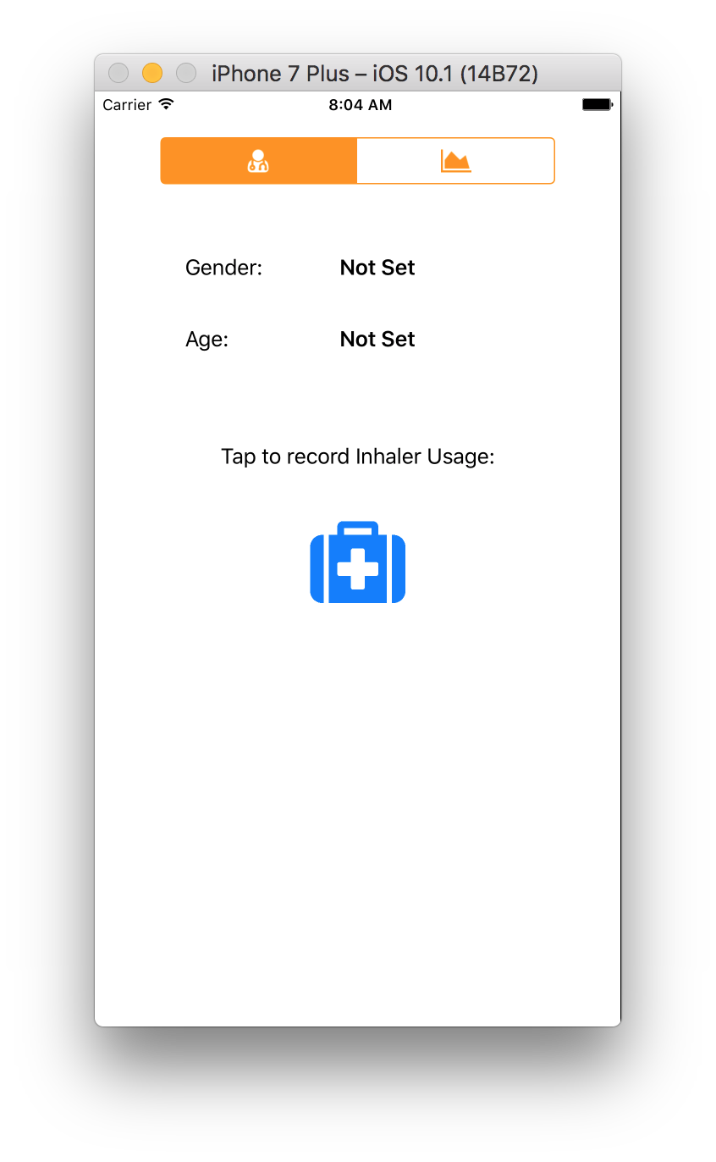
Project Config and Navigation
Link HealthKit/MapKit/ResearchKit
HealthKit in Target’s Capabilities
Info.plist Usage Descriptions
HealthKit Share
HealthKit Update
Location Services - When In Use
Basic Navigation Using Two Embedded View Controllers

Slide 26
// Wrap Health Store in HealthKitAdapter
class HealthKitAdapter: NSObject {
static let sharedInstance = HealthKitAdapter()
private let healthKitStore = HKHealthStore()
}
Notes:
HealthKitAdapter

Slide 27
// I. Authorization
let typesToShare : Set = [inhalerUsageQuantitityType]
let typesToRead : Set = [inhalerUsageQuantitityType,
dobCharacteristicType,
genderCharacteristicType]
if(HKHealthStore.isHealthDataAvailable()){
self.healthKitStore.requestAuthorization(
toShare: typesToShare,
read: typesToRead)
{success, error in
print("check success")
}
}

Slide 28
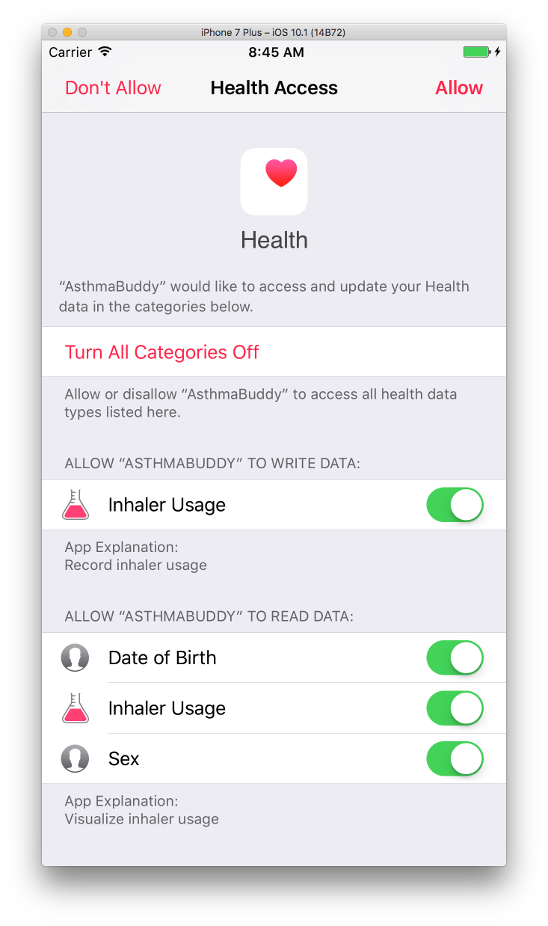

Slide 29
// II. Get Characteristics
do {
let dob = try healthKitStore.dateOfBirthComponents().date!
let gender = try healthKitStore.biologicalSex()
completion(dob, gender.biologicalSex)
} catch {
print("Error")
}

Slide 30
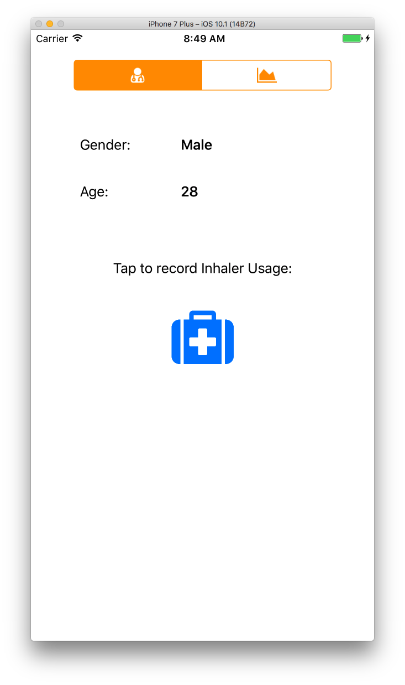
Notes:
If still not set, check health app, profile icon
Extra slide for Health app

Slide 31
// III. Save samples
let sample = HKQuantitySample(
type: inhalerUsageQuantitityType,
quantity: quantityOne,
start: date,
end: date
)
healthKitStore.save(sample) { (success, error) in
print("saved one use to health kit")
}

Slide 32
Notes:
If still not set, check health app, profile icon
Extra slide for Health app

Slide 33
// III. Save samples with location
let coordinateString = "\(lat),\(lon)"
let sample = HKQuantitySample(
type: inhalerUsageQuantitityType,
quantity: quantityOne,
start: date,
end: date,
metadata: [usageLocationKey:coordinateString]
)
healthKitStore.save(sample) { (success, error) in
print("saved one use to health kit, with location")
}
Notes:
Metadata can only contain string, date or number. So only serializing coordinates from CLLocation

Slide 34
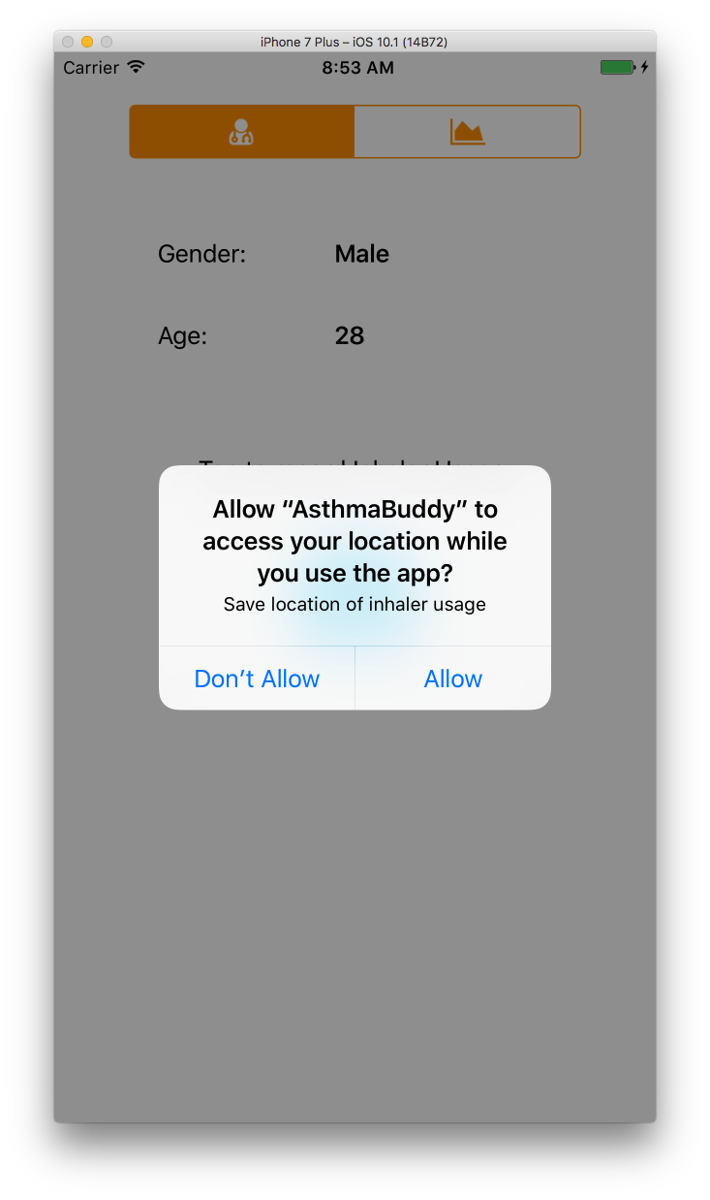
Notes:
Default location is Bay Area, if you want to use simulator, pick denver from list
On device, should be more scattered

Slide 35
// IV: Get data for chart and map
let query = HKSampleQuery(
sampleType: inhalerUsageQuantitityType,
predicate: nil,
limit: 100,
sortDescriptors: nil)
{ (query, samples, error) in
completion(samples as? [HKQuantitySample])
}
self.healthKitStore.execute(query)

Slide 36
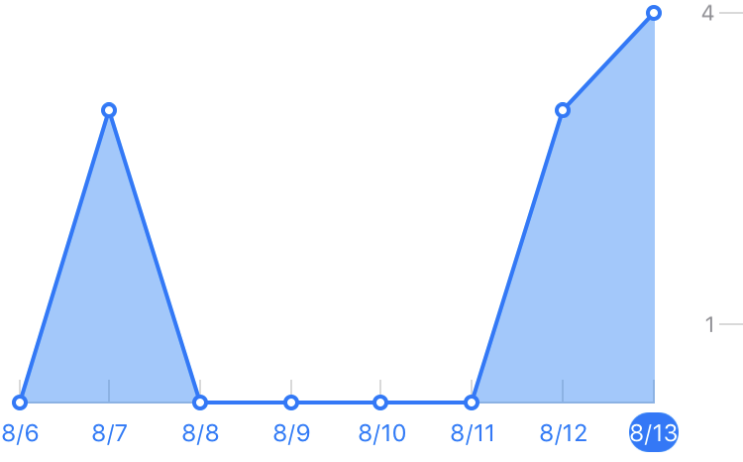
ResearchKit Charts
Line Graph
Value Range Datasource
Point for index
Number of points for plot
Number of plots
Title for X Axis at index
Notes:
Was easy to work with
Research kit also has bar charts

Slide 37
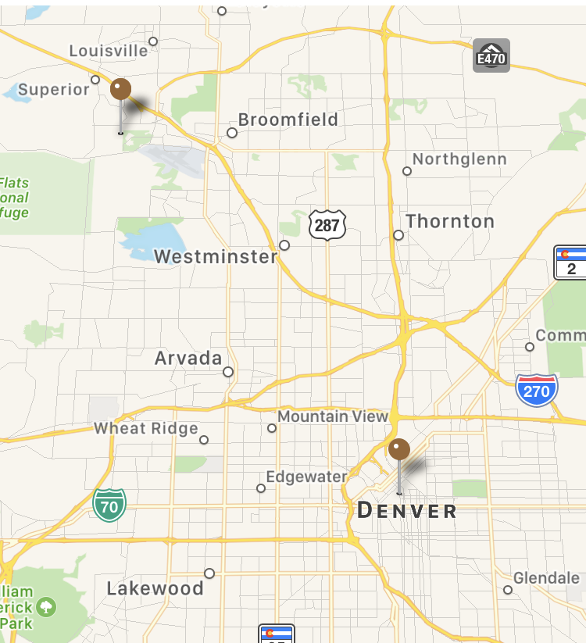
Map Visualization
Map View
Map View Delegate
View for Annotation
Extended HKQuantitySample implement MKAnnotation
Add annotations to Map View
Notes:
GPX with mountain drive

Slide 38
Demo
Notes:
Open AsthmaBuddy

Slide 39
III. HIPAA And You

Slide 40
HIPAA Is…
Health Insurance Portability and Accountability Act of 1996
If applicable, you must:
Protect PHI at rest and in motion
Minimize use and sharing of PHI
Agreements with Business Associates to safeguard PHI
Training and procedures to protect PHI
Notes:
passed in 1996, and among other things, outlines the requirements for the management of, storage and transmission of protected health information (PHI) in both physical and digital form

Slide 41
PHI
CHI
Doctor billing
Email to doctor's office about a medication
Appointment with doctor's office
An MRI scan
Blood test results
Pedometer steps
Calories burned
Blood sugar readings w/out personally identifiable information (PII)
Heart rate readings w/out PII
Inhaler usage not shared with Doctor

Slide 42
Covered Entity and Business Associates
Covered Entity is anyone who provides treatment, payment and operations in healthcare.
Hospital
Dialysis Clinic
Doctor’s Office
Insurance Provider
Business Associate is a vendor or subcontractor who has access to PHI.
Email vendor
Cloud storage provider
Payment platform
Notes:
Covered Entities Include:
Doctor’s office, dental offices, clinics, psychologists,
Nursing home, pharmacy, hospital or home healthcare agency
Health plans, insurance companies, HMOs
Government programs that pay for healthcare
Health clearing houses

Slide 43
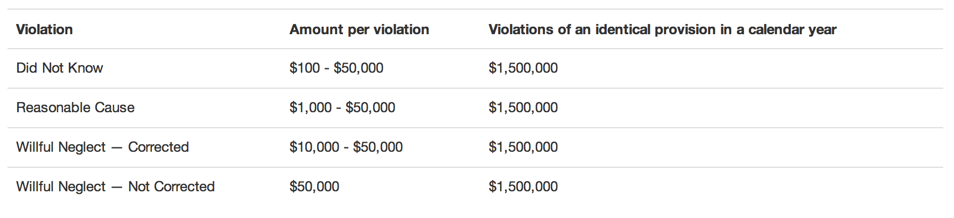
HIPAA Fines
Source: HHS, Federal Register.gov
Notes:
If you can pay these

Slide 44
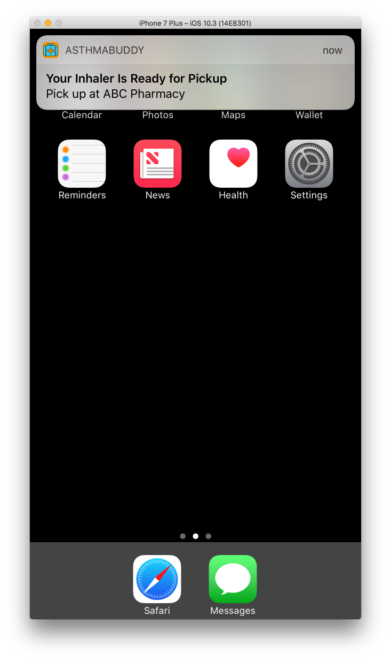
App Stuff
Push Notifications
Emails/automated calls
Integrations
Encryption
Lock screen
Enabling remote wiping of lost phones
Notes:
Hosting
Network and application security
High-Availability and Redundancy
PaaS
TrueValut
AWS?

Slide 45
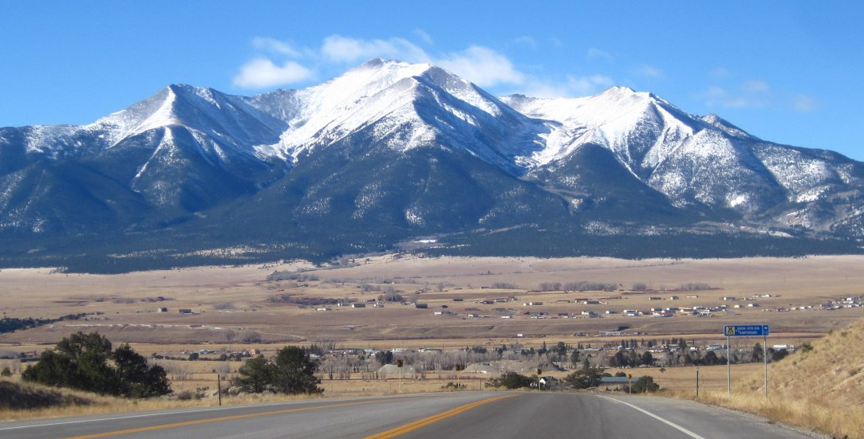
Thank you!
DaVita (MCoE) is hiring iOS and DevOps: http://careers.davita.com
Twitter, GitHub: @Iiiggs

